Slide 1
Section 5.4 Graphing Tangent Functions
© Copyright all rights reserved to Homework depot: www.BCMath.ca

Slide 2
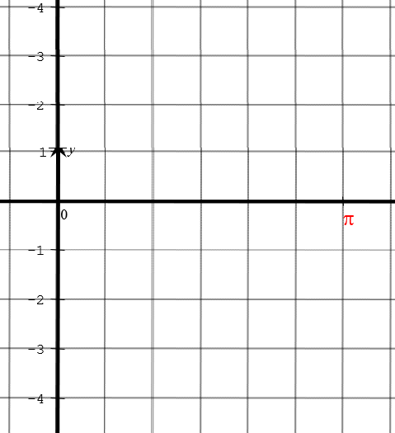
I) Graphing a Tangent Function:
2 ways to understand what the tangent function is:
Method 1: The tangent function is the “Y” coordinate divided by the “X” coordinate of Point “P”, as we rotate the terminal arm with angle Ø

Slide 3
Properties of a Tangent Function:
When the terminal arm is pointing UP (90˚) or DOWN (270˚), we have VERTICAL ASYMPTOTES, b/c the “X” coordinate is zero [Can’t divide by zero]
When the terminal is pointing RIGHT (0˚ or 360˚) or LEFT (180˚), we have “X” intercepts, b/c the “Y” coordinate is zero!
The midpoint of the “X” intercepts and Asymptote is “like” the amplitude, $A=1$
Remember, tanØ is positive in Q1, Negative in Q2, Positive in Q3, Neg in Q4
y
3
2
1
x
0
0
π
π
2π
3π
2π
3π
-1
-2
-3

Slide 4
II) Tangent as the Y-coordinate on the Vertical Tangent Line
The tangent function can be defined as the y-coordinate of the extension of the terminal arm on a vertical tangent line
When you rotate the terminal arm, the extension creates a right triangle with a base of 1
The tangent function will be the Y-coordinate of this point on the Vertical tangent
© Copyright all rights reserved to Homework depot: www.BCMath.ca

Slide 5
As the terminal arm rotates around the circle, it will cross the tangent line above the X-axis (+’ve) or below the X-axis (–’ve )
Ie: when the terminal arm is in Q1, it crosses the tangent line above the X-axis, so tanθ is positive
At any point when the terminal arm is pointing side ways, the value of tanθ is equal to zero
At any point when it’s pointing up or down, the value of tanθ is undefined, because it doesn’t touch the tangent line
In Q2, the terminal arm extends to the tangent line beneath the X-axis, so it will be negative
In Q3, it crosses the tangent line above the X-axis, so tanθ is positive
In Q4, it crosses the tangent line under the X-axis, so tan θ is negative
© Copyright all rights reserved to Homework depot: www.BCMath.ca

Slide 6
The tangent function can be defined as the y-coordinate of the extension of the terminal arm on a vertical tangent line
As the angle changes and increase, the value of tanθ will fluctuate from negative to positive infinity
y
2
x
0
0.5π
π
1.5π
2π
2.5π
3π
3.5π
4π
4.5π
-2
© Copyright all rights reserved to Homework depot: www.BCMath.ca

Slide 7
Main Ideas of Graphing Tangent Functions:
The most important thing about graphing tangent functions is finding the Vertical Asymptotes, [ie: 90˚, 270˚, 450˚,…]
The middle between two Vertical asymptotes will be the “X” intercepts
The middle between an X-intercept and Vertical asymptote will have a height of ‘A”
To the RIGHT of the X-intercept it will have a height of “A” units above the X-axis. To the LEFT, it have a height of “A” units below the X-axis.
y
3
2
1
0
π
2π
3π
x
0
π
2π
3π
-1
-2
-3

Slide 8
II) Transformations with the Tangent Function:
Use the function tool kit from ch1 to find the transformations with the following tangent function:
Vertical
Shifts
Vertical Expansions or Compressions
Horizontal Expansions or Compressions
Horizontal Shifts
Ex: Indicate the transformation with the following equations:
Vertical expansion by a factor of 2
Vertical shift of 6 units up
Horizontal compression by a factor of
Period is now:
Vertical Asymptotes
Divide each V.A by 3
© Copyright all rights reserved to Homework depot: www.BCMath.ca

Slide 9
Practice: Indicate all the transformations with the following equations and find the following:
i) Vertical Asymptotes ii) Period iii) Domain and Range
Vertical compression by a factor of 0.5
Horizontal compression by a factor of
Period is now:
Horizontal shift of π units right
Vertical shift of 4 units down
Vertical Asymptotes
Apply compressions first and then the shift to the right
General Formula for the Asymptote:
Domain:
Range:
© Copyright all rights reserved to Homework depot: www.BCMath.ca

Slide 10
Practice: Indicate all the transformations with the following equations and find the following:
i) Vertical Asymptotes ii) Period iii) Domain and Range
Vertical compression by a factor of 0.25
Horizontal compression by a factor of
Period is now:
Horizontal shift of 1 unit right
Vertical shift of 3 units down
Vertical Asymptotes
General Formula for the Asymptote:
Domain:
Range:
© Copyright all rights reserved to Homework depot: www.BCMath.ca

Slide 11
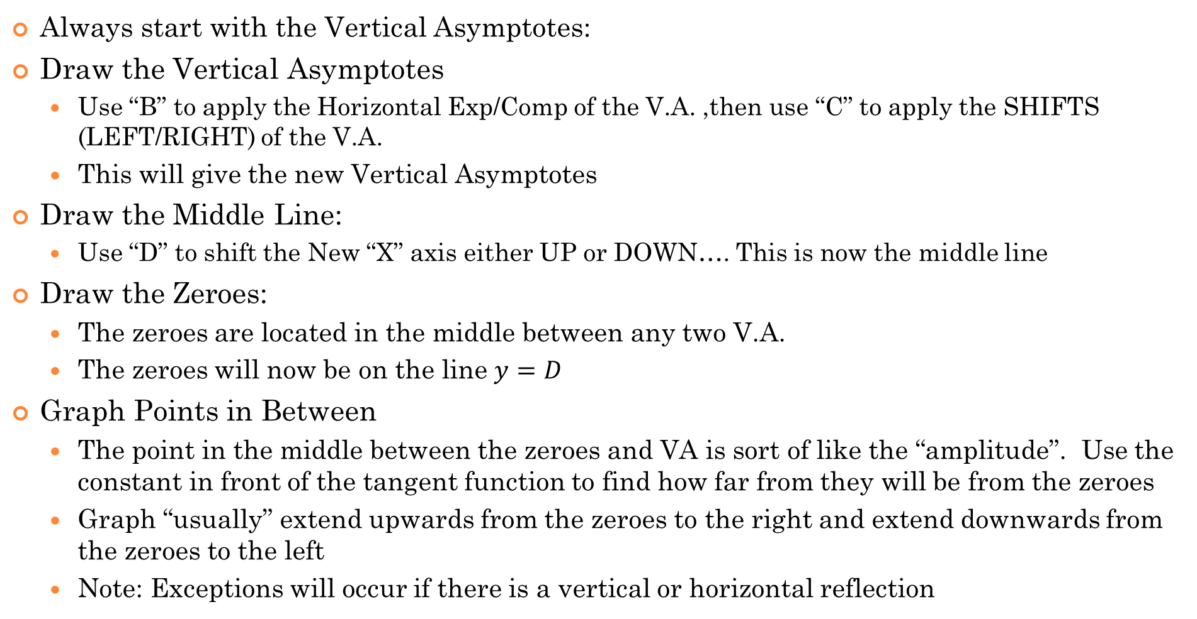
III) Graphing Tangent Functions with Transformations:
Always start with the Vertical Asymptotes:
Draw the Vertical Asymptotes
Use “B” to apply the Horizontal Exp/Comp of the V.A. ,then use “C” to apply the SHIFTS (LEFT/RIGHT) of the V.A.
This will give the new Vertical Asymptotes
Draw the Middle Line:
Use “D” to shift the New “X” axis either UP or DOWN…. This is now the middle line
Draw the Zeroes:
The zeroes are located in the middle between any two V.A.
The zeroes will now be on the line $y=D$
Graph Points in Between
The point in the middle between the zeroes and VA is sort of like the “amplitude”. Use the constant in front of the tangent function to find how far from they will be from the zeroes
Graph “usually” extend upwards from the zeroes to the right and extend downwards from the zeroes to the left
Note: Exceptions will occur if there is a vertical or horizontal reflection
© Copyright all rights reserved to Homework depot: www.BCMath.ca

Slide 12
Ex: Graph the following function:
Horizontal expansion by a factor of 2
Vertical Asymptotes
Horizontal shift of π units right
Zeroes in the middle between 2 asymptotes
Vertical shift of 4 units up
Therefore, all zeroes will be shifted 4 units up
Vertical expansion of by a factor of 3
Points in the middle between zero & asymptote will be 3 units up or down from the center
y
9
8
7
6
5
4
3
2
1
x
−6π
−4π
−2π
0
2π
4π
6π
-1
© Copyright all rights reserved to Homework depot: www.BCMath.ca

Slide 13
Ex: Graph the following function:
Hor. Expan. by a factor of
Vertical Asymptotes
Horizontal shift of 3 units left
Zeroes in the middle between 2 asymptotes
Vertical shift of 2 units down
Therefore, all zeroes will be shifted 2 units down
Vert. Expans. by a factor of – 2 (VR)
Points in the middle between zero & asymptote will be 2 units up or down from the center
y
1
x
-6
-4
-2
0
2
4
6
-1
-2
-3
-4
-5
© Copyright all rights reserved to Homework depot: www.BCMath.ca

Slide 14
EX: Given the following graph, find the values of A, B,& C if the function is in the form of:
y
4
3
2
1
x
−2π
−1.5π
−π
−0.5π
0
0.5π
π
1.5π
2π
2.5π
3π
-1
-2
-3
-4
1st Find the period
Use the horiz. distance between two V.A.
2nd Find the H.S.
Use the zeroes to find H.S.
3rd Vertical Exp/ Compr.
Use the middle points to find the Vertical stretch
© Copyright all rights reserved to Homework depot: www.BCMath.ca

